Slide 1
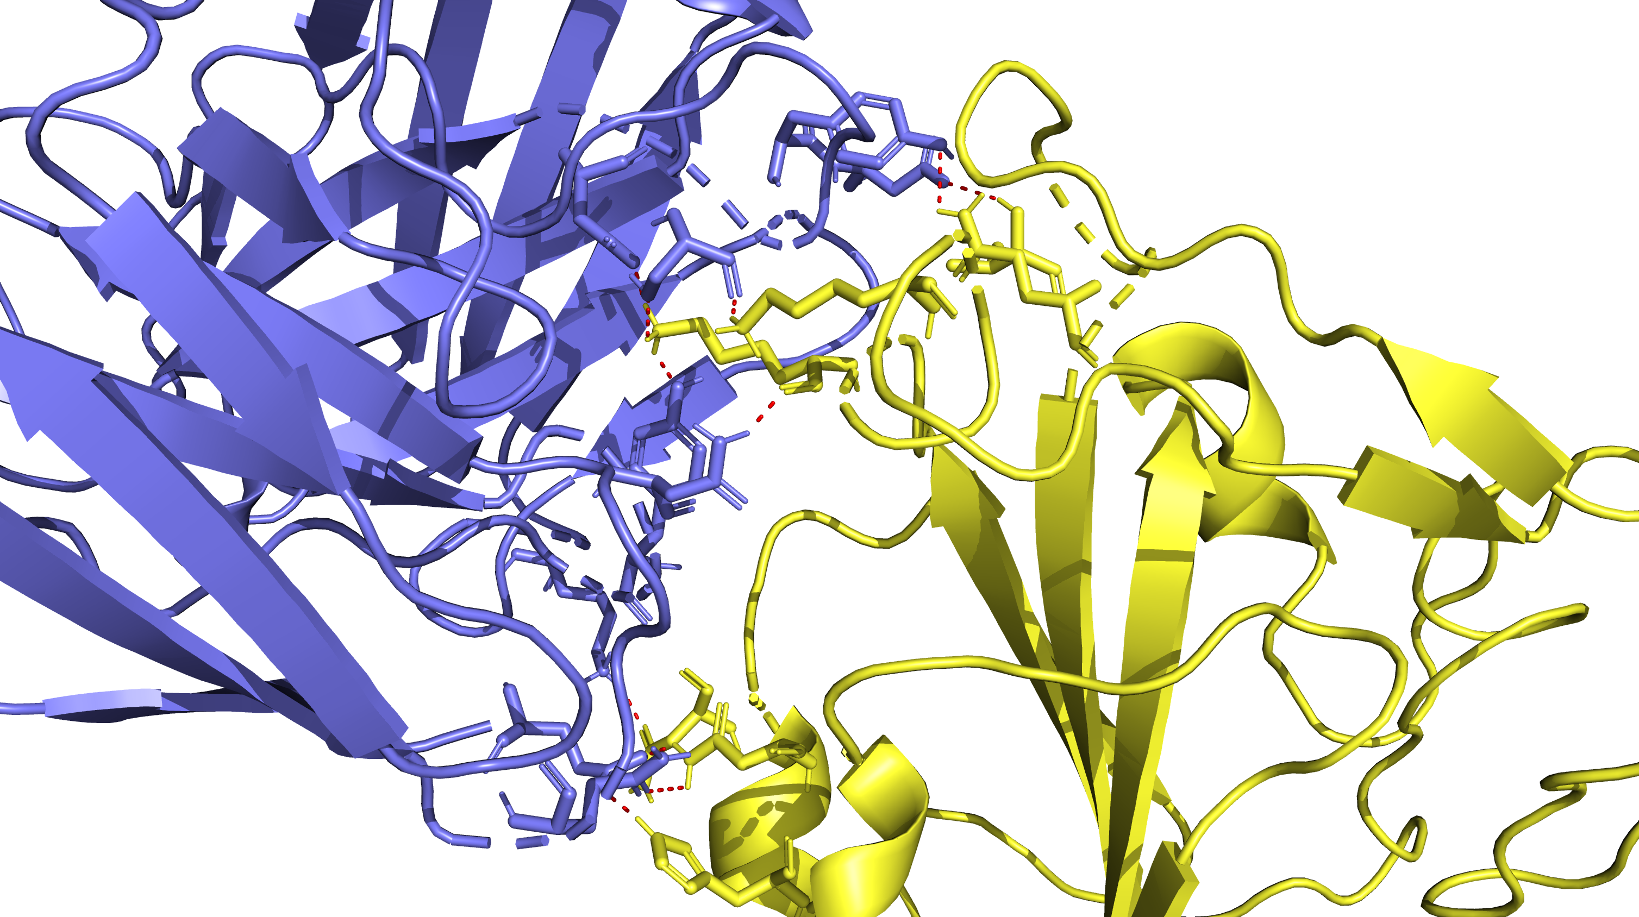
XBB.1.5 in Complex with 7x2h
V503
K444
Q506
K440
N370
N343
H339

Slide 2
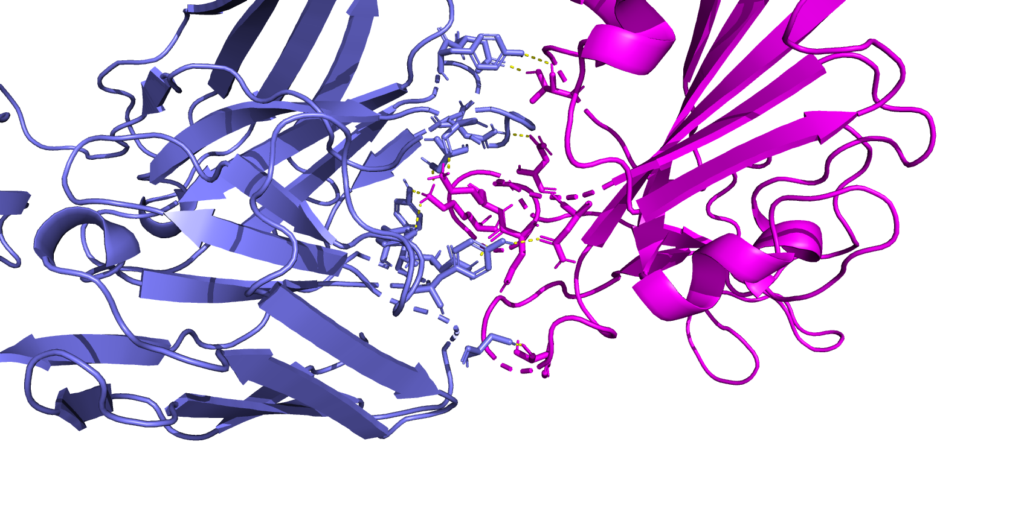
AB 7x2h complexed with BA.2.86
T345
N447
K439
K443
N436
N438
Y506

Slide 3
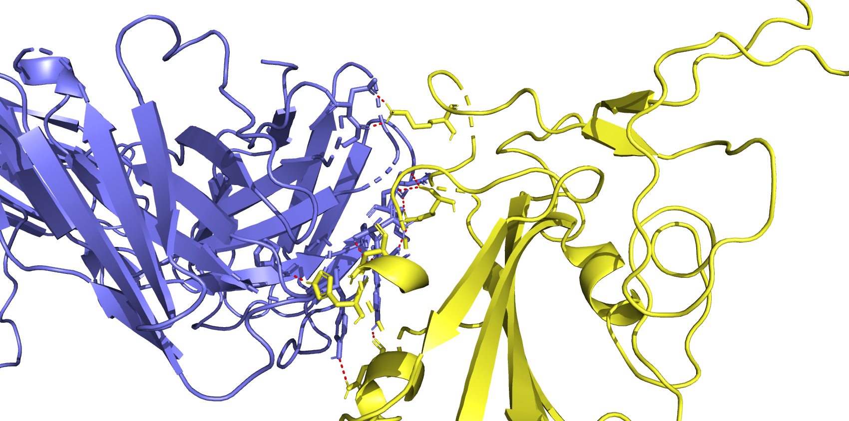
AB 8DW9 complexed with XBB.1.5
K444
K440
N343
H339
N370

Slide 4
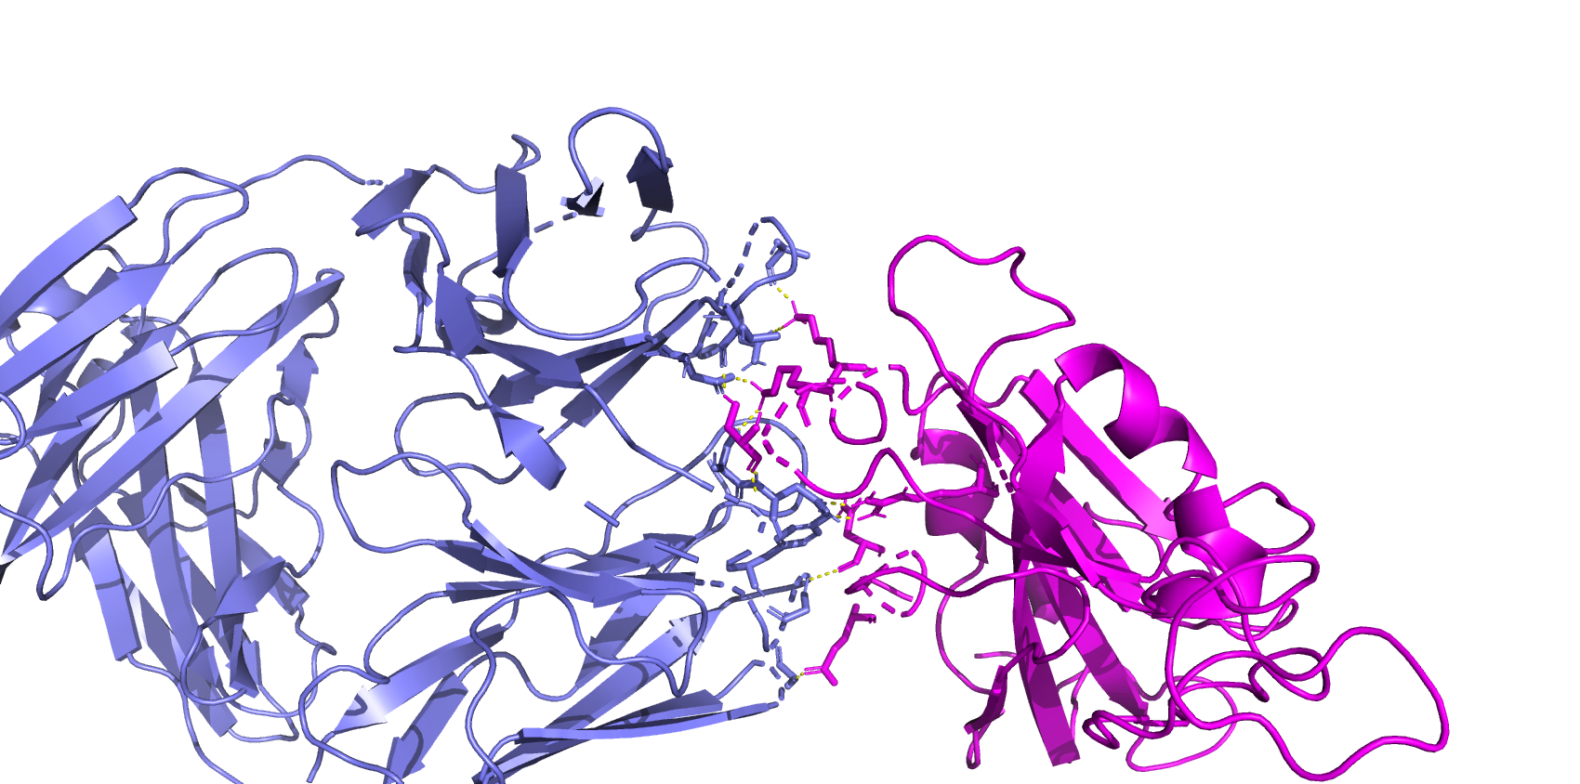
BA286 complex w 8DW9 AB
K439
K443
S445
R506
N343
E340

Slide 5
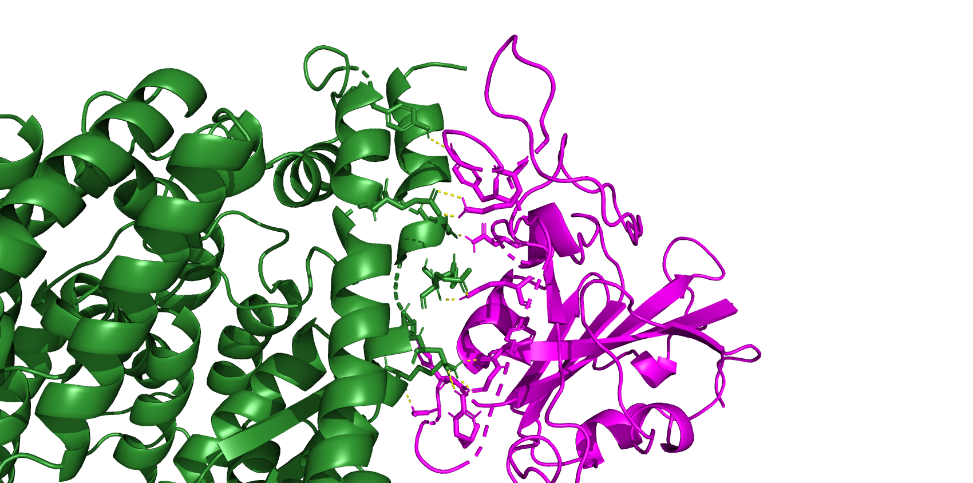
6M0J ACE2 Complexed with BA.2.86
BA286 and 6m0j
Y486
K481
N416
Q490
H502
Y492
G493
G499
R495

Slide 6
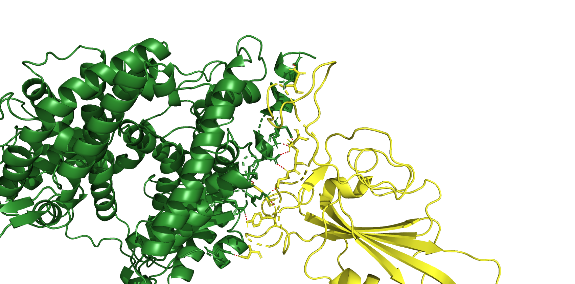
XBB15 Complexed with 6M0J ACE2
N487
Q493
S490
S494
R498
Y449
S446

Slide 7
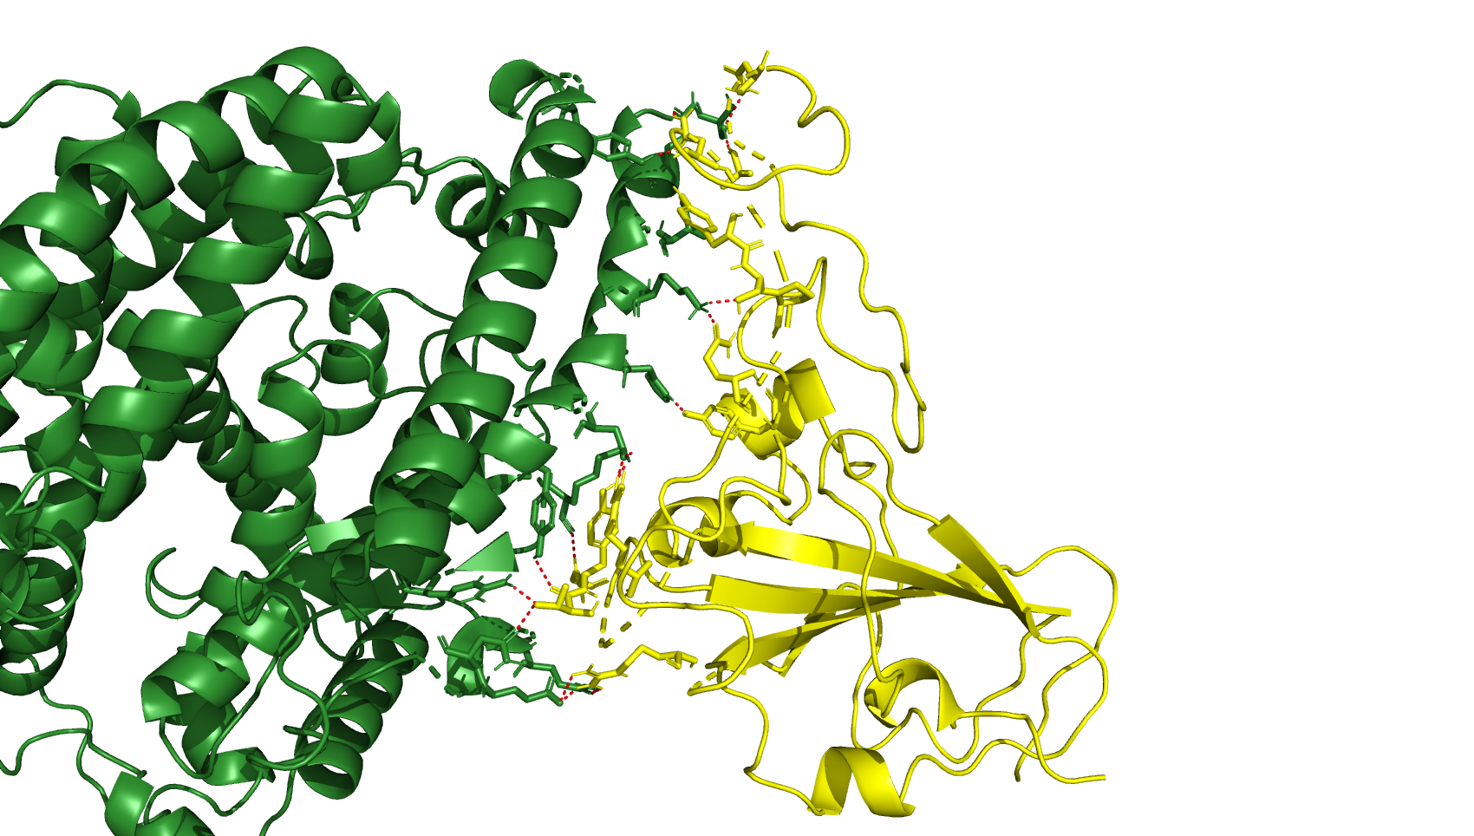
XBB15 Complexed with 6M0J ACE2 Fixed
N477
N477
N487
A475
Y489
S494
R498
Q493
S490
Y449
S446

Slide 8
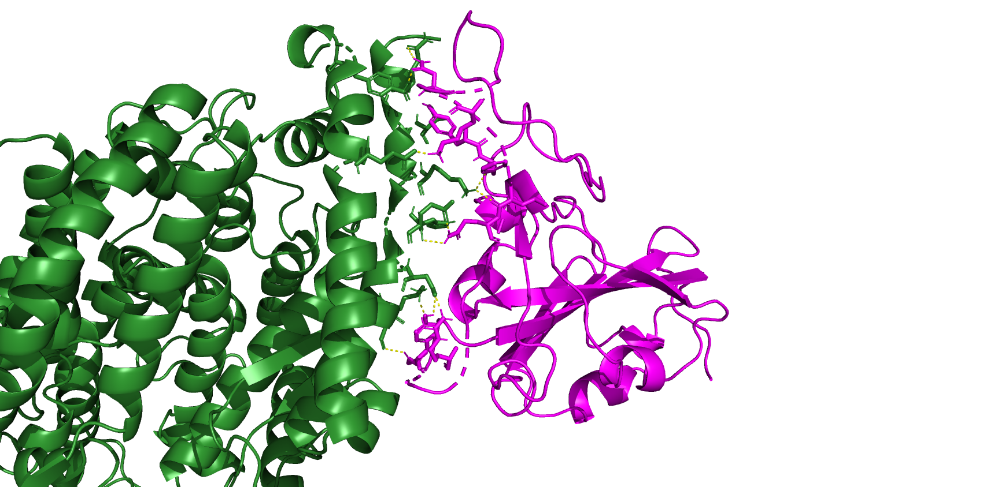
N484
BA286 and ACE2 8SPI
Y486
K481
F487
L489
Q490
Y498
R495
G499

Slide 9
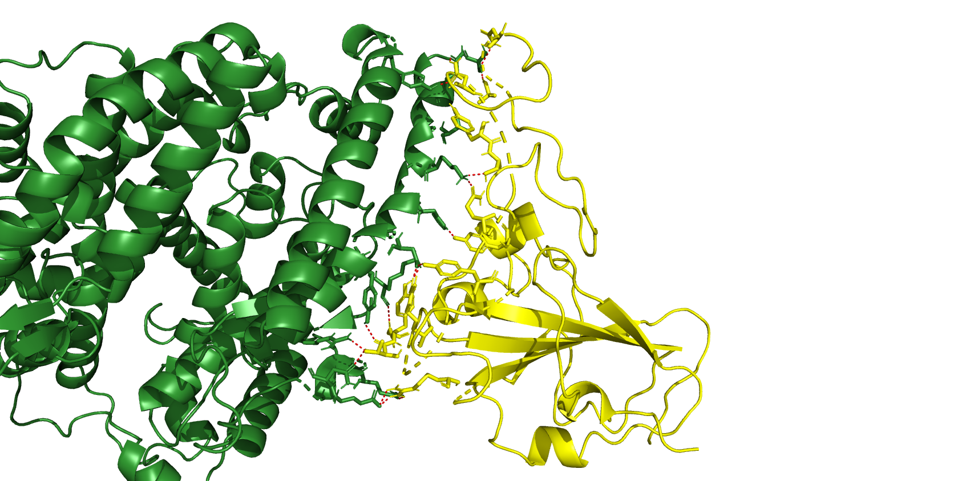
XBB15 and ACE2 8SPI
N477
N487
A475
Y489
S490
Q493
Y453
Y449
Y501
R498
G502
T500
R439

Slide 10
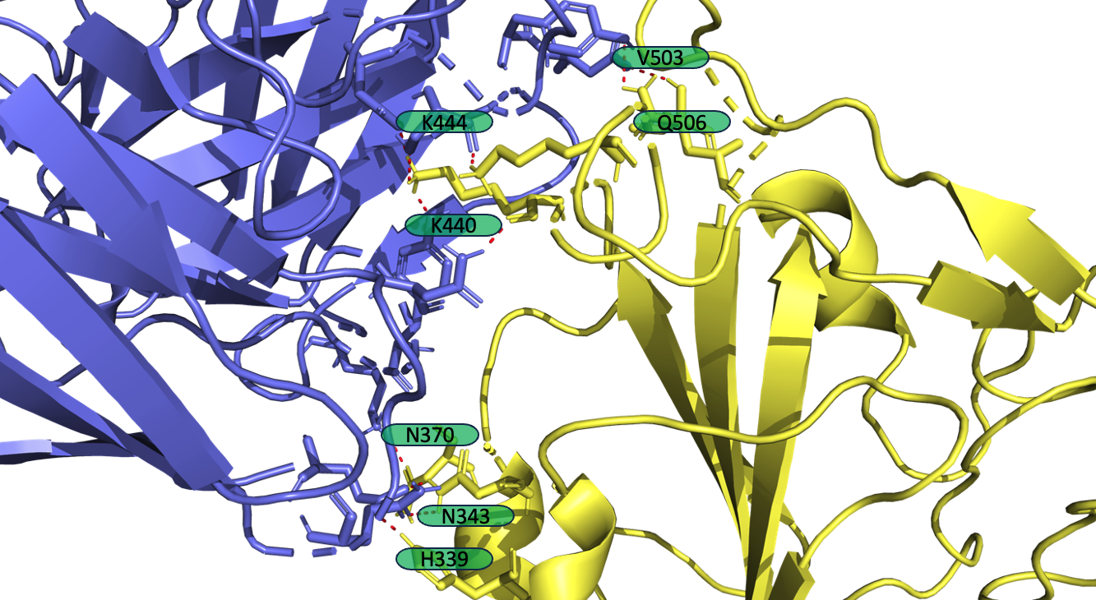
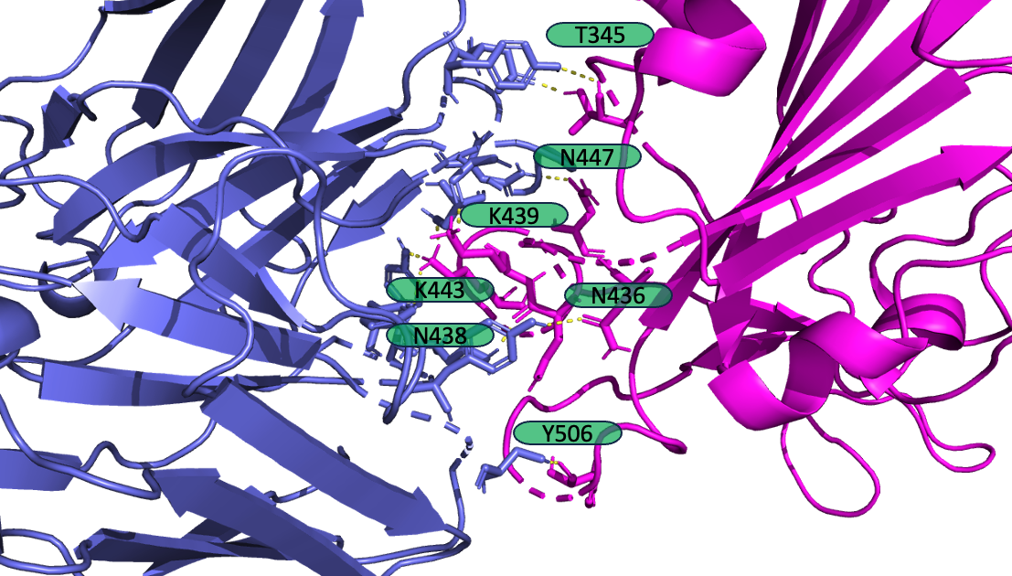
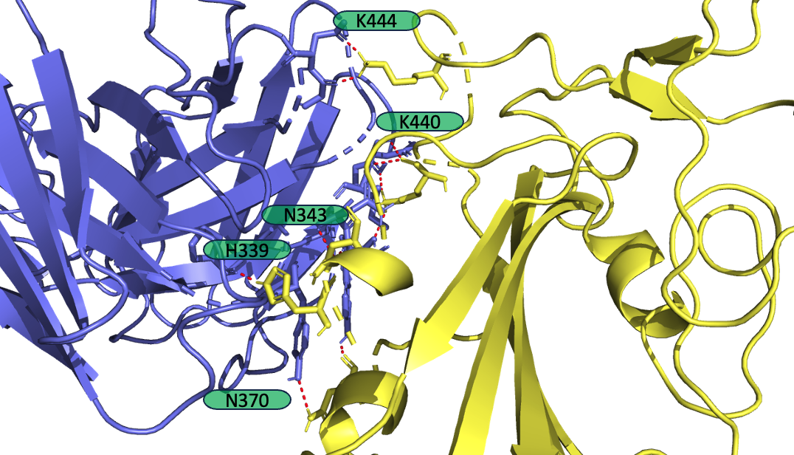
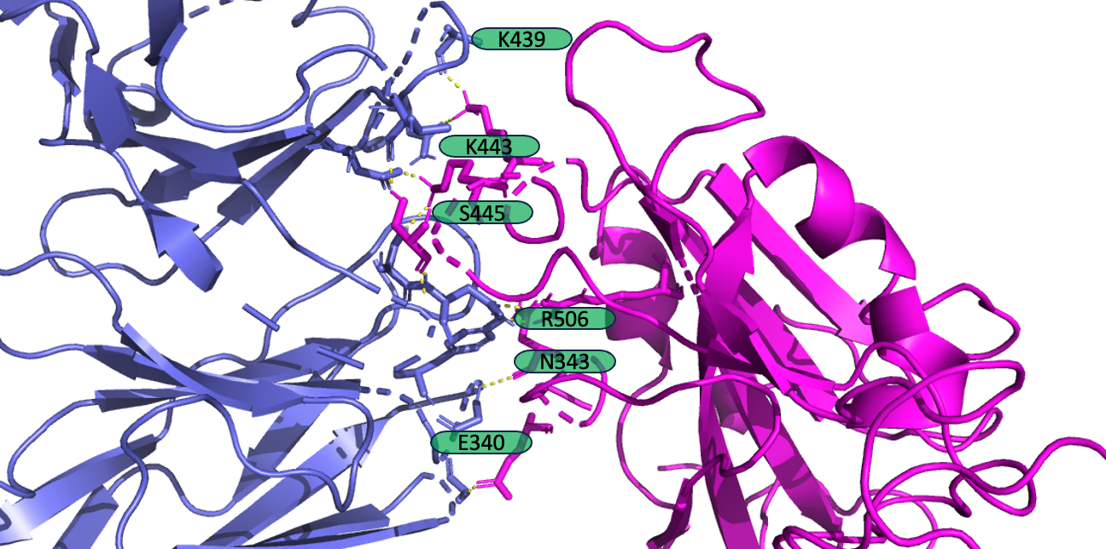
Antibody Analysis 2x2 table
(A)
(B)
(C)
(D)

Slide 12
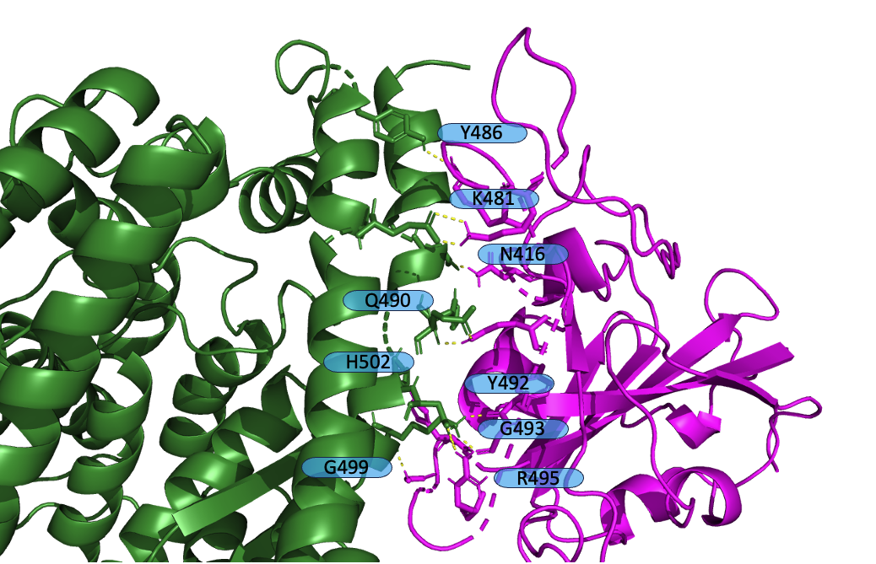
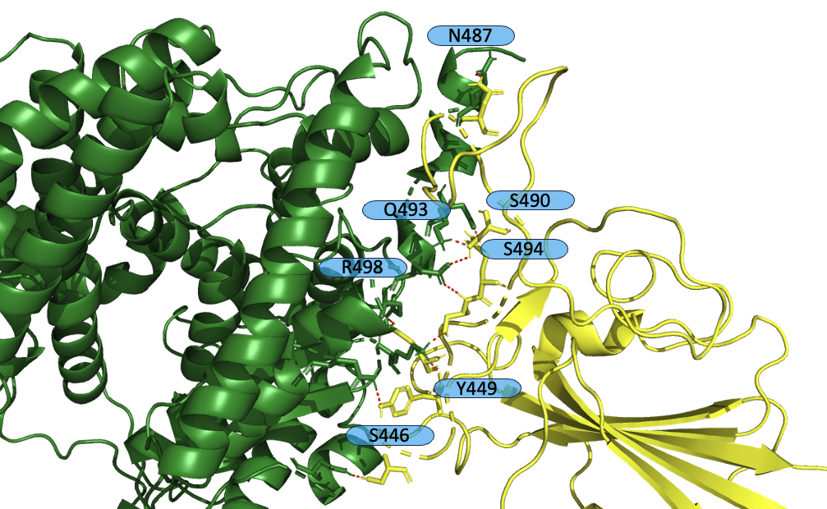
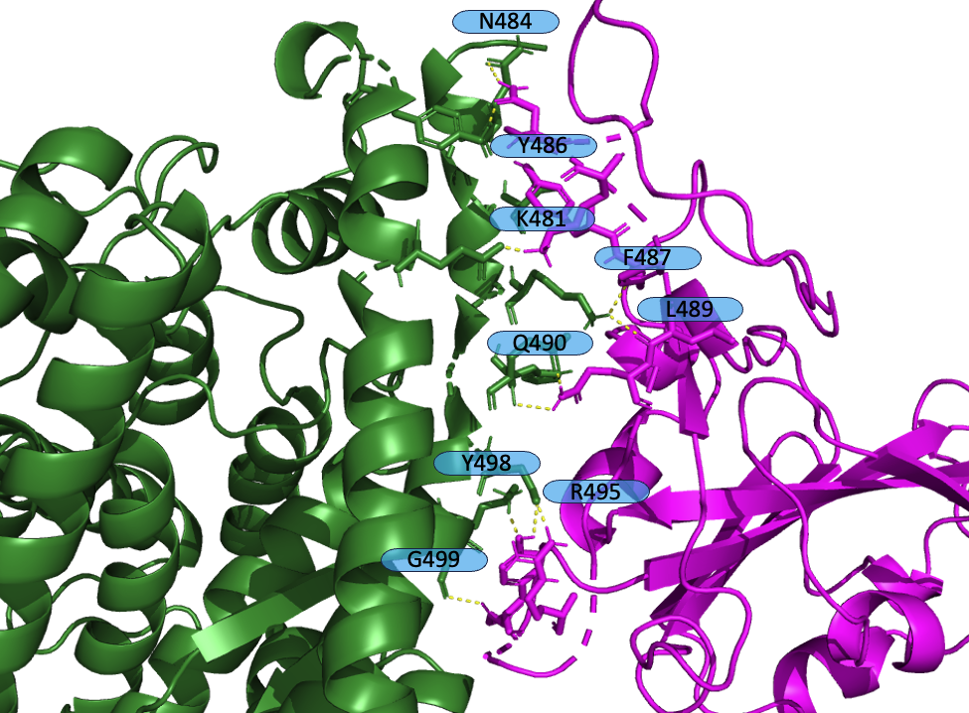
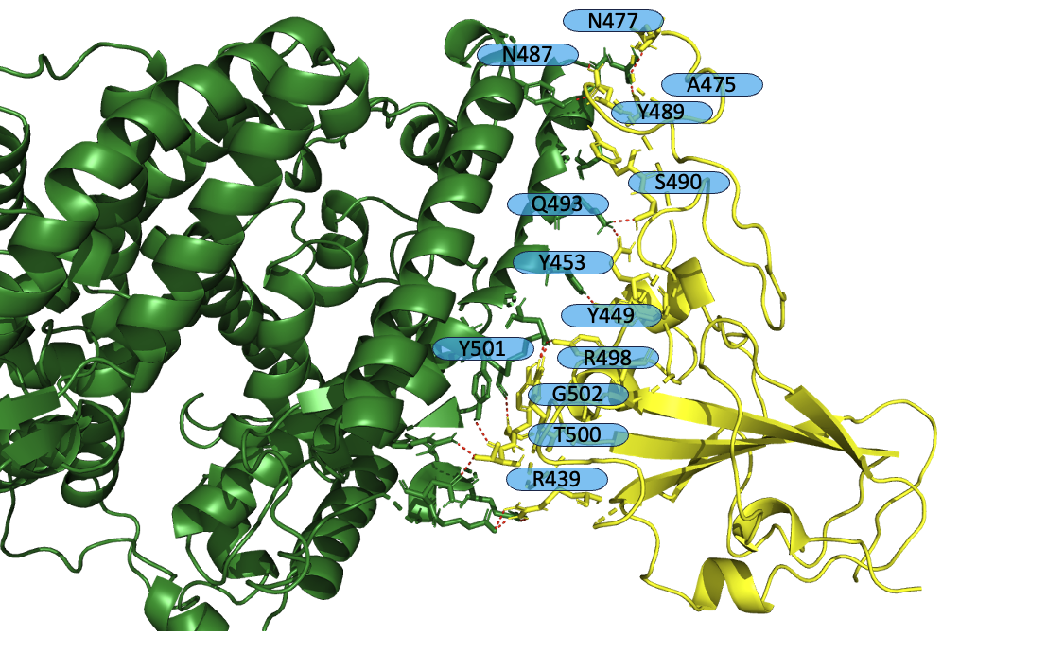
ACE2 Analysis 2x2 table
(A)
(B)
(C)
(D)

Slide 13
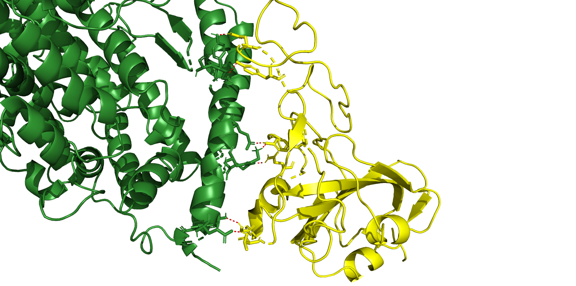
7a98 XBB.1.5
N487
Y489
Y453
Q409
G502
T500

Slide 14
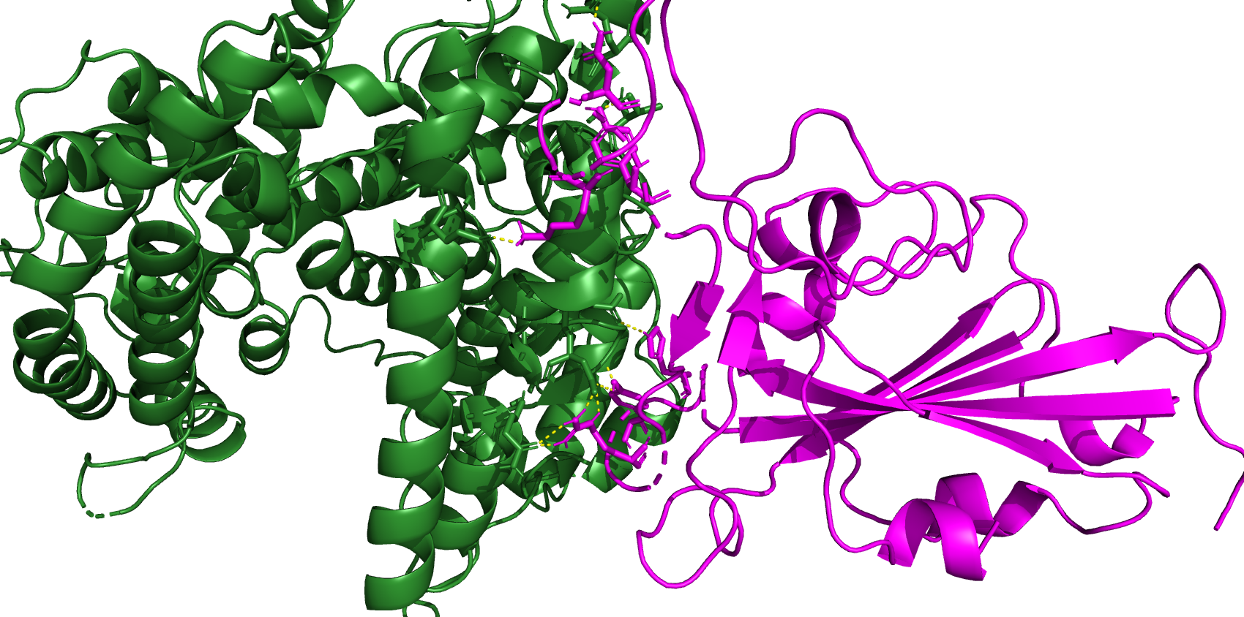
7a98 BA.2.86
N484
Y486
K481
H502
R495
Y498

Slide 15
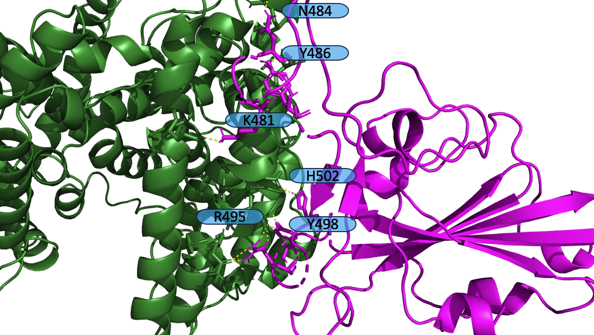
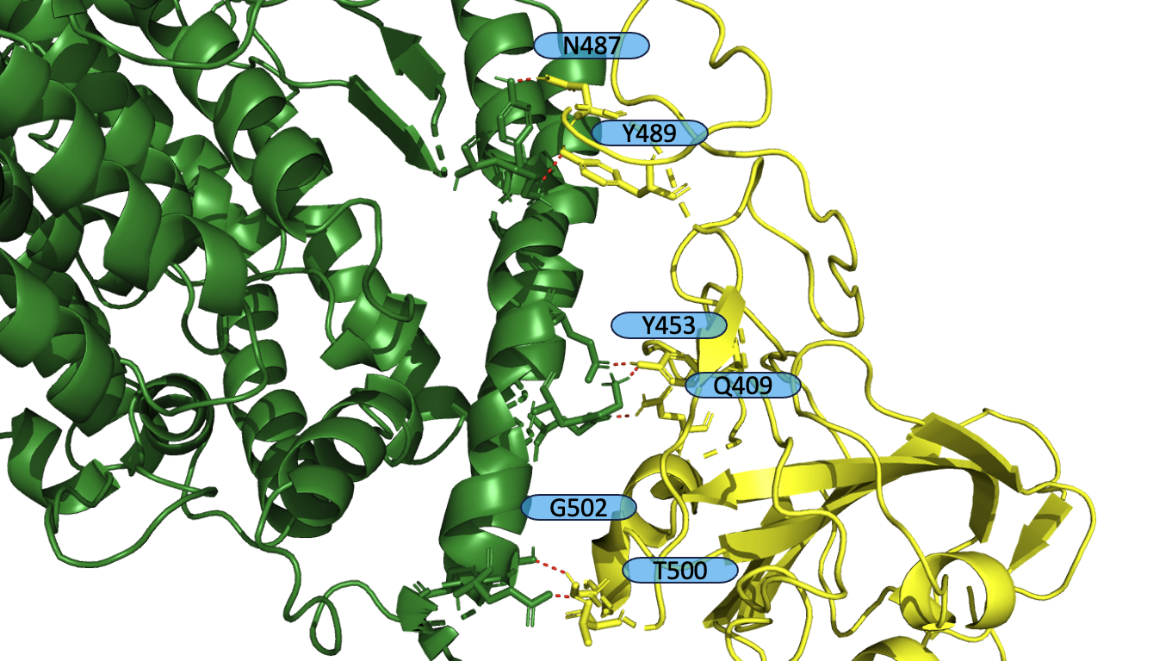
ACE2 Analysis 2x2 table
(A)
(B)
(C)
(D)

